Slide 1
PROJECT ON MYSQL
-CONNECTING PYTHON TO MYSQL WITH MYSQL.CONNECTOR
Presented By: Gunnam Supraja
ID : AF04957411

Slide 2
PROJECT OVERVIEW
This project is a Python–MySQL mini database management system.
It connects Python with a MySQL database named testPython using mysql.connector.
A DBHelper class is defined to handle database operations efficiently.
The program creates a user table with fields: user id, username, and phone.
It supports full CRUD operations: insert, fetch, delete, and update user records.
insert_user adds new users while avoiding duplicate IDs.
fetch_data displays all stored user details in a readable format.
delete_row removes a user, and update_user modifies existing details.
A menu-driven main() function makes the program interactive for users.
This project is a simple example of managing records in real-world applications.

Slide 3
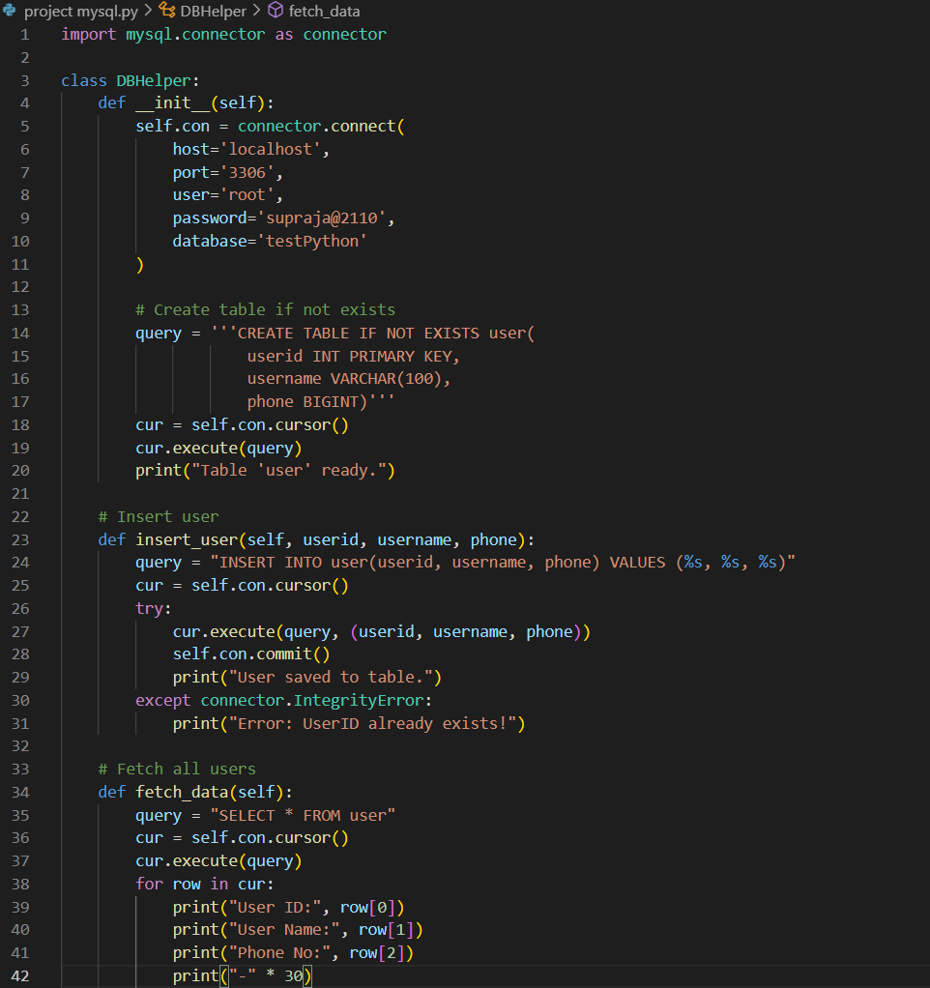
SOURCE CODE

Slide 4
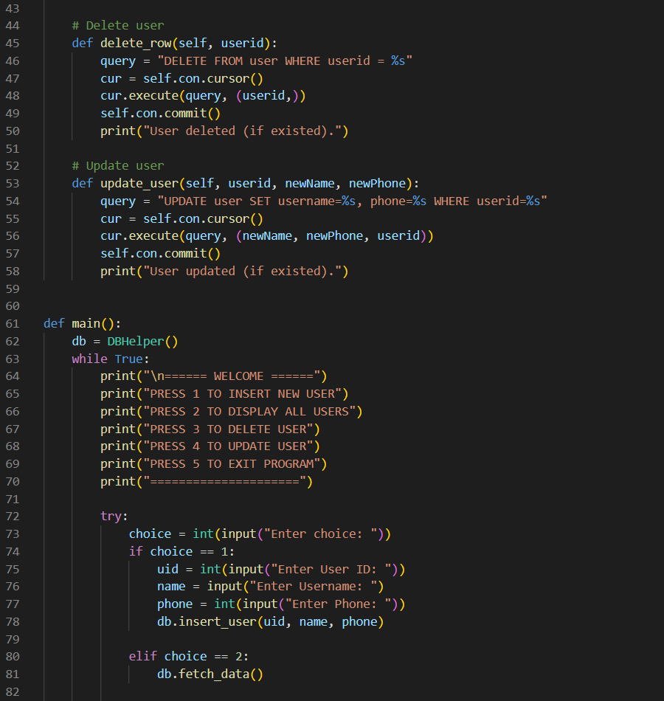

Slide 5
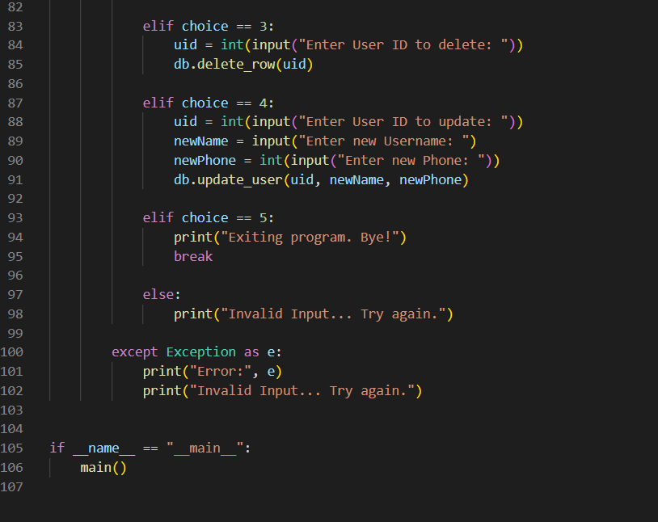

Slide 6
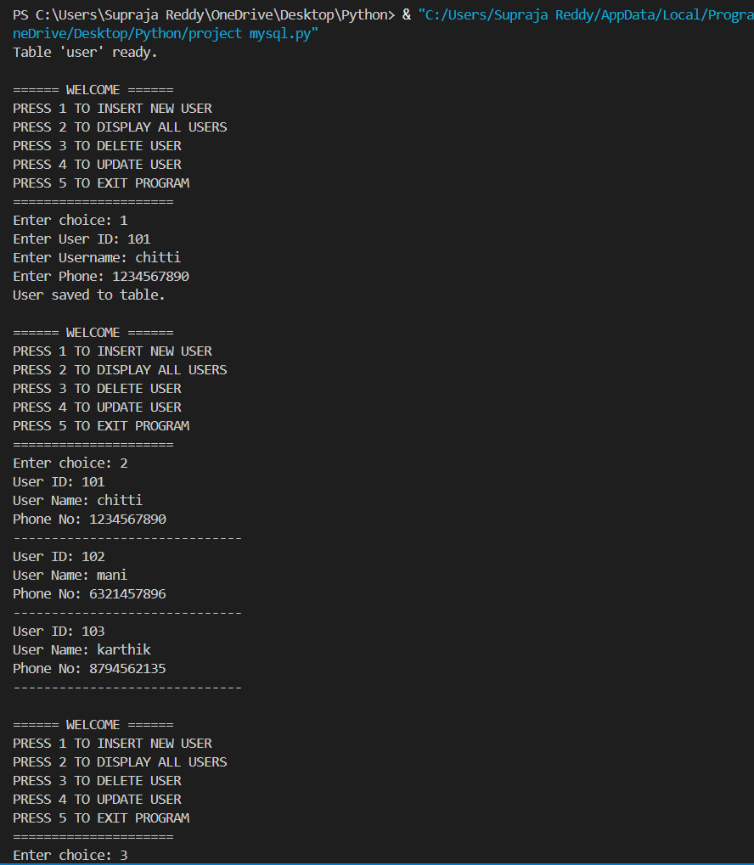
Output

Slide 7
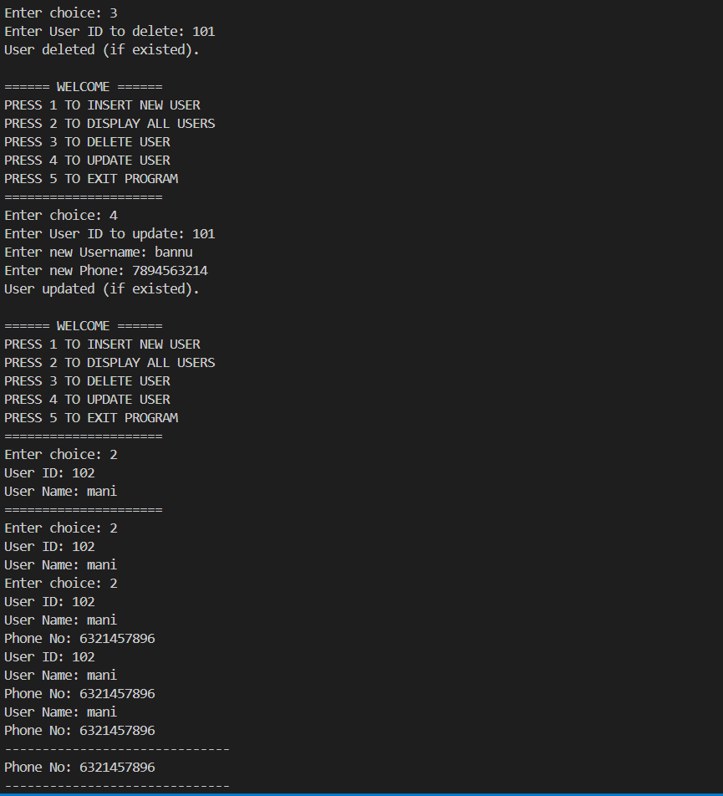

Slide 8
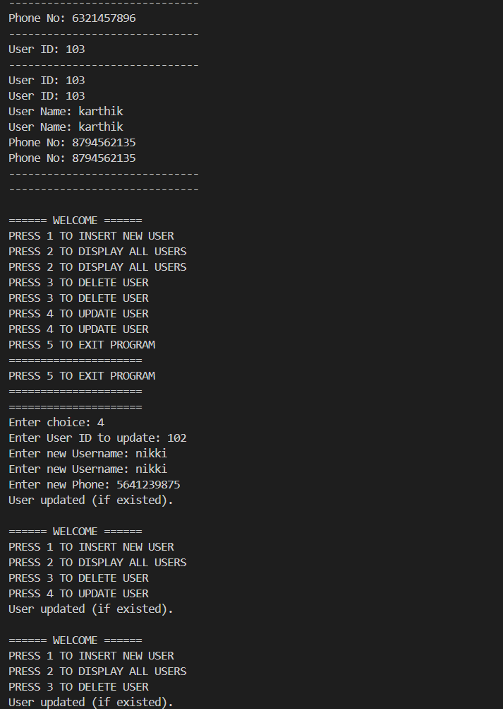

Slide 9
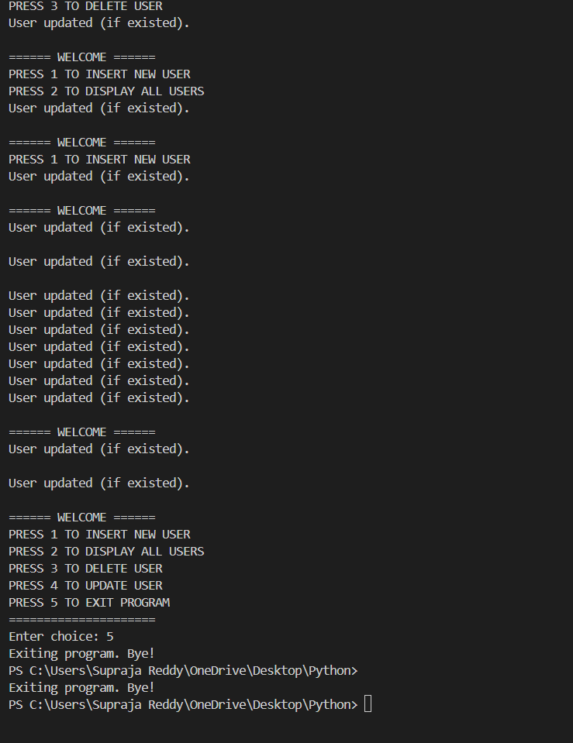

Slide 10
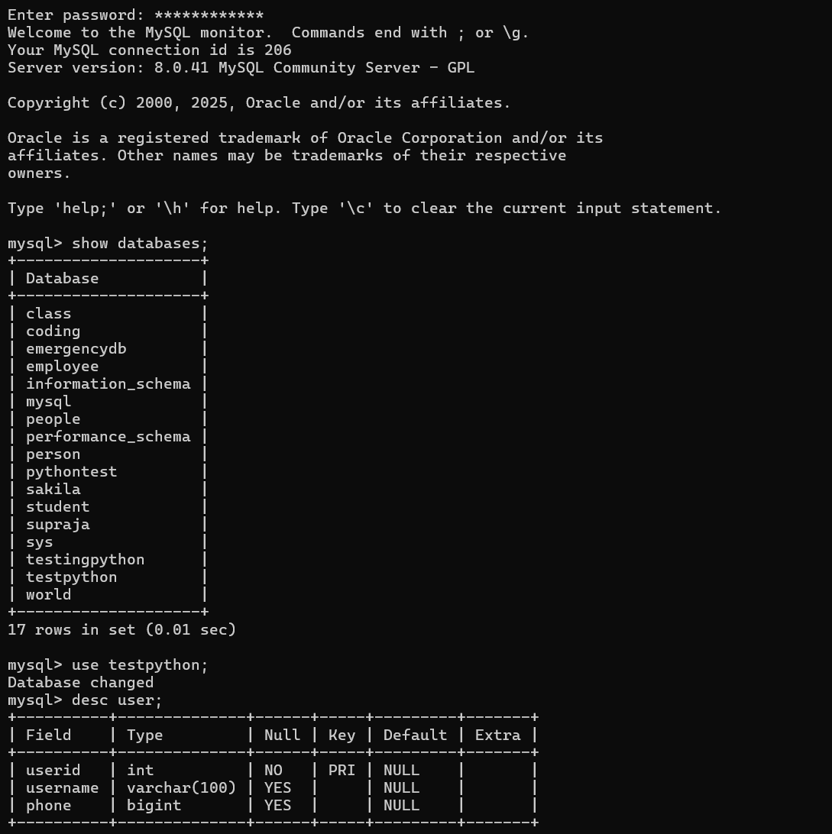
QUERIES PERFORMED IN MYSQL COMMAND CLIENT

Slide 11
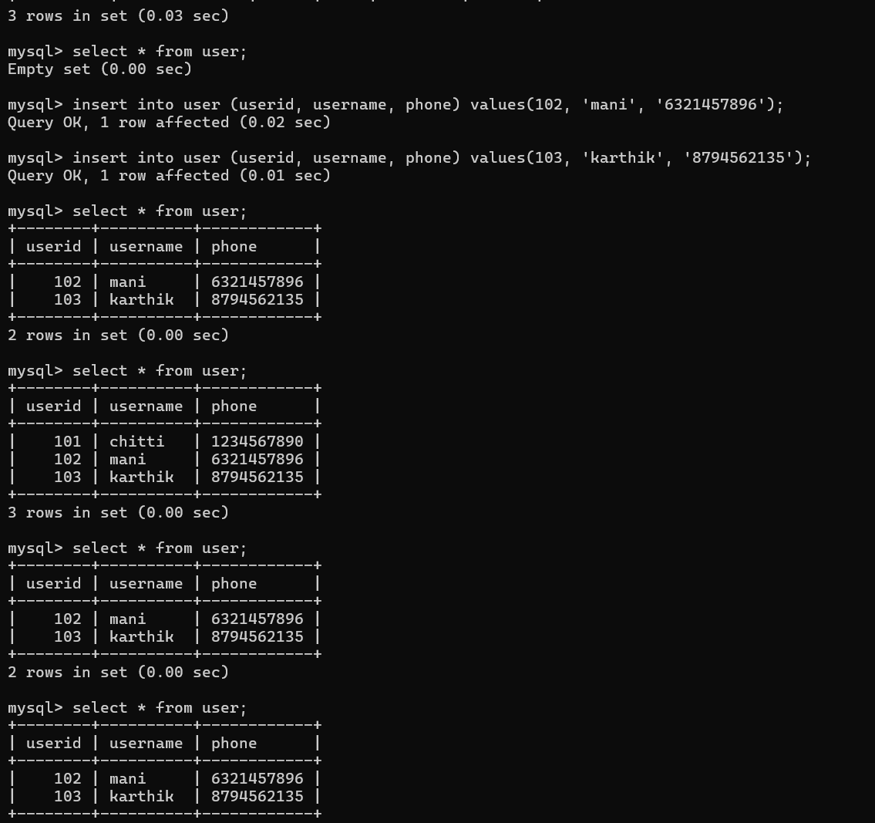

Slide 12
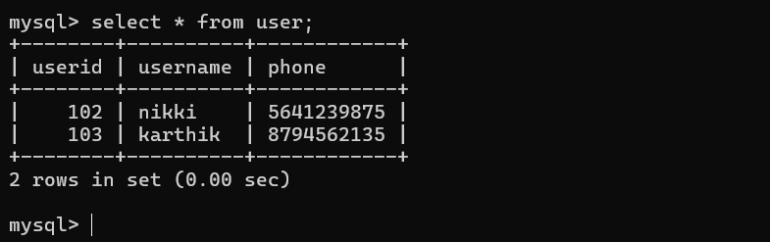

Slide 13
CONCLUSION
This project demonstrates how Python can be effectively integrated with MySQL to build a simple database management system.
By implementing essential CRUD operations, it provides a practical way to store, retrieve, update, and delete user records.
The menu-driven interface makes it interactive and user-friendly, while error handling ensures smooth execution.
Overall, the project serves as a strong foundation for understanding database connectivity, query execution, and application development in Python, and it can be extended into larger systems such as employee management, student records, or inventory tracking.

Slide 14
THANK YOU

